Slide 1
KNN and Probability

Slide 2
Classification
Definition
Classification can take two distinct meanings in Machine Learning
Unsupervised Learning
We may be given a set of observations with the aim of establishing the existence of classes or clusters in the data
Supervised Learning
We may know for certain that there are so many classes, and the aim is to establish a rule that we can use to classify a new observation into one of the existing classes
k-NN is a supervised method for classification

Slide 3
Classification
A few classification examples:
A Person arrives at the emergency room with a set of symptoms that could possibly be attributed to one of three medical conditions. Which of the three conditions does the individual have?
An online banking service must be able to determine whether or not a transaction being performed on the site is fraudulent, on the basis of the user’s IP address, past transaction history, and so forth.
On the basis of DN sequence data for a number of patients with and without a given disease, a biologist would like to figure out which DNA mutations are disease-causing and which are not.

Slide 4
Classification
There are many possible techniques that a classifier might use to predict a qualitative response. Today we will discuss k-NN
k-Nearest Neighbors
Naïve Bayes
Logistic Regression
Tree – based methods

Slide 5
Classification
A few issues to keep in mind when building a classifier
Accuracy. There is the reliability of the rule, usually represented by the proportion of correct classifications, although it may be that some errors are more serious than others, and it may be important to control the error rate for some key class.
Speed. In some circumstances, the speed of the classifier is a major issue. A classifier that is 85% accurate may be preferred over one that is 95% accurate if it is 100 times faster in testing (and such differences in time-scales are not uncommon in neural networks for example).
Such considerations would be important for the automatic reading of postal codes, or automatic fault detection of items on a production line for example.

Slide 6
Classification
A few issues to keep in mind when building a classifier
Comprehensibility. If it is a human operator that must apply the classification procedure, the procedure must be easily understood else mistakes will be made in applying the rule. It is important also, that human operators believe the system.
Training Time. Especially in a rapidly changing environment, it may be necessary to learn a classification rule quickly, or make adjustments to an existing rule in real time. “Quickly” might imply also that we need only a small number of observations to establish our rule.

Slide 7
K-Nearest Neighbors

Slide 8
Simple approach for k-NN
Simple goal:
Predict the label of a data point by:
Looking at the ‘k’ closest labeled data points (neighbors)
Uses a majority vote
One of the easiest algorithms to interpret, oftentimes used as a baseline for measuring model performance
Memory-Based Learning
Also known as “case-based” or “example-based” learning
Intuition behind memory-based learning
Similar inputs map to similar outputs
If true, we just have to define “similar”
Not all similarities created equal…

Slide 9
Memory-Based Learning
How do we determine “similar”?
For instance, if we wanted to:
Predict Brian’s weight
Who are the similar people?
Similar age, diet, height, waistline, activity level …
Predict Brian’s IQ
Similar occupation, writing style, undergraduate degree, SAT score, …
How do we calculate variously ranges in similarity?
Need some metric…
Distance

Slide 10
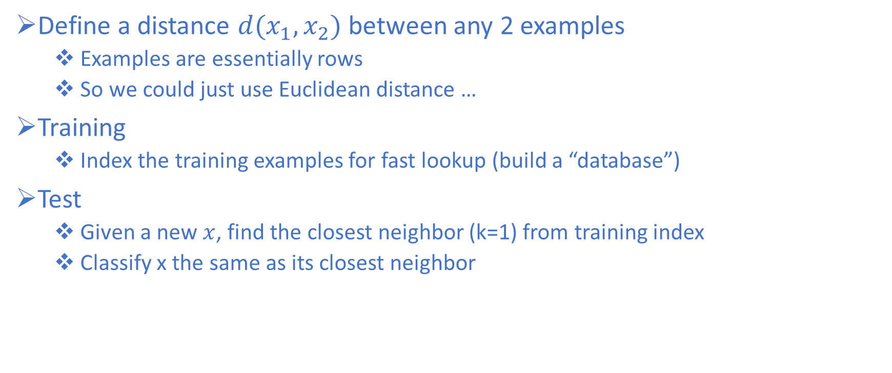
k-NN Approach
Define a distance $d(x_{1},x_{2})$between any 2 examples
Examples are essentially rows
So we could just use Euclidean distance …
Training
Index the training examples for fast lookup (build a “database”)
Test
Given a new $x$, find the closest neighbor (k=1) from training index
Classify x the same as its closest neighbor

Slide 11
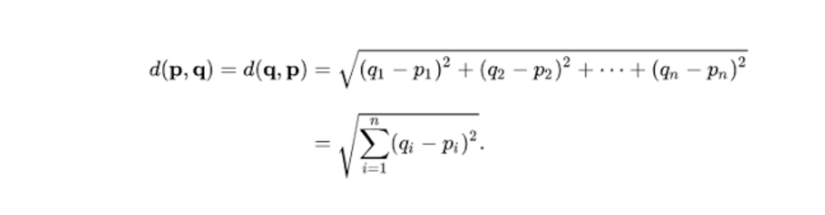
k-NN Approach
Euclidean Distance Equation:
p & z are the current data and q is new, think of p & z as the training and q as the test.
Subtracting then squaring row p with q. Then summing and taking the sqrt.
Do the same with z and compare
 | x1 | x2 | x3 | x4 | x5 | x6 | x7 | x8 | Result
q | 3 | 2 | 2 | 5 | 6 | 2 | 1 | 5
p | 4 | 3 | 3 | 6 | 4 | 4 | 5 | 6
Euclidean | 1 | 1 | 1 | 1 | 4 | 4 | 16 | 1 | 5.39
z | 3 | 2 | 2 | 5 | 6 | 2 | 1 | 5
Euclidean | 0 | 0 | 0 | 0 | 0 | 0 | 0 | 0 | 0

Slide 12
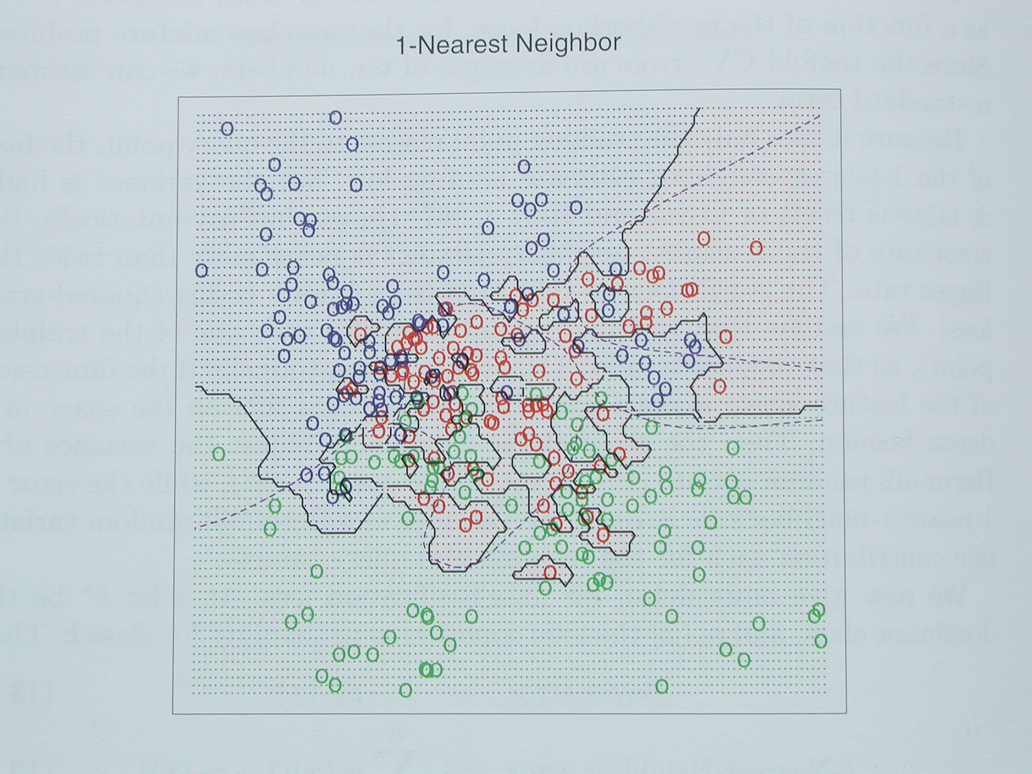
kNN Decision Boundaries
kNN can learn complex decision boundaries

Slide 13
kNN
Instead of picking the (1) nearest neighbor, what if we picked the k-Nearest Neighbors and have them vote?
Choosing k points is more reliable in the following cases:
Noise in training vectors x
Noise in training labels y
Overlapping classes
o
k=1
+
o
o
o
o
x_2
o
o
o
o
o
+
+
o
o
o
+
o
+
+
+
+
+
+
+
+
x_1

Slide 14
kNN
Instead of picking the (1) nearest neighbor, what if we picked the k-Nearest Neighbors and have them vote?
Choosing k points is more reliable in the following cases:
Noise in training vectors x
Noise in training labels y
Overlapping classes
Why?
o
X
+
o
o
o
k=1
o
o
o
o
o
o
+
+
o
o
+
o
o
x_2
+
+
+
+
+
+
+
+
x_1

Slide 15
kNN Decision Boundaries
Consider this example with R,G,B classes with significant overlap

Slide 16
kNN Decision Boundaries
Consider this example with R,G,B classes with significant overlap
k=1 Decision Boundary
Looks complex
Overfitting?

Slide 17
kNN Decision Boundaries
k=1 Decision Boundary
Looks complex
Overfitting?
What if we were to increase k?

Slide 18
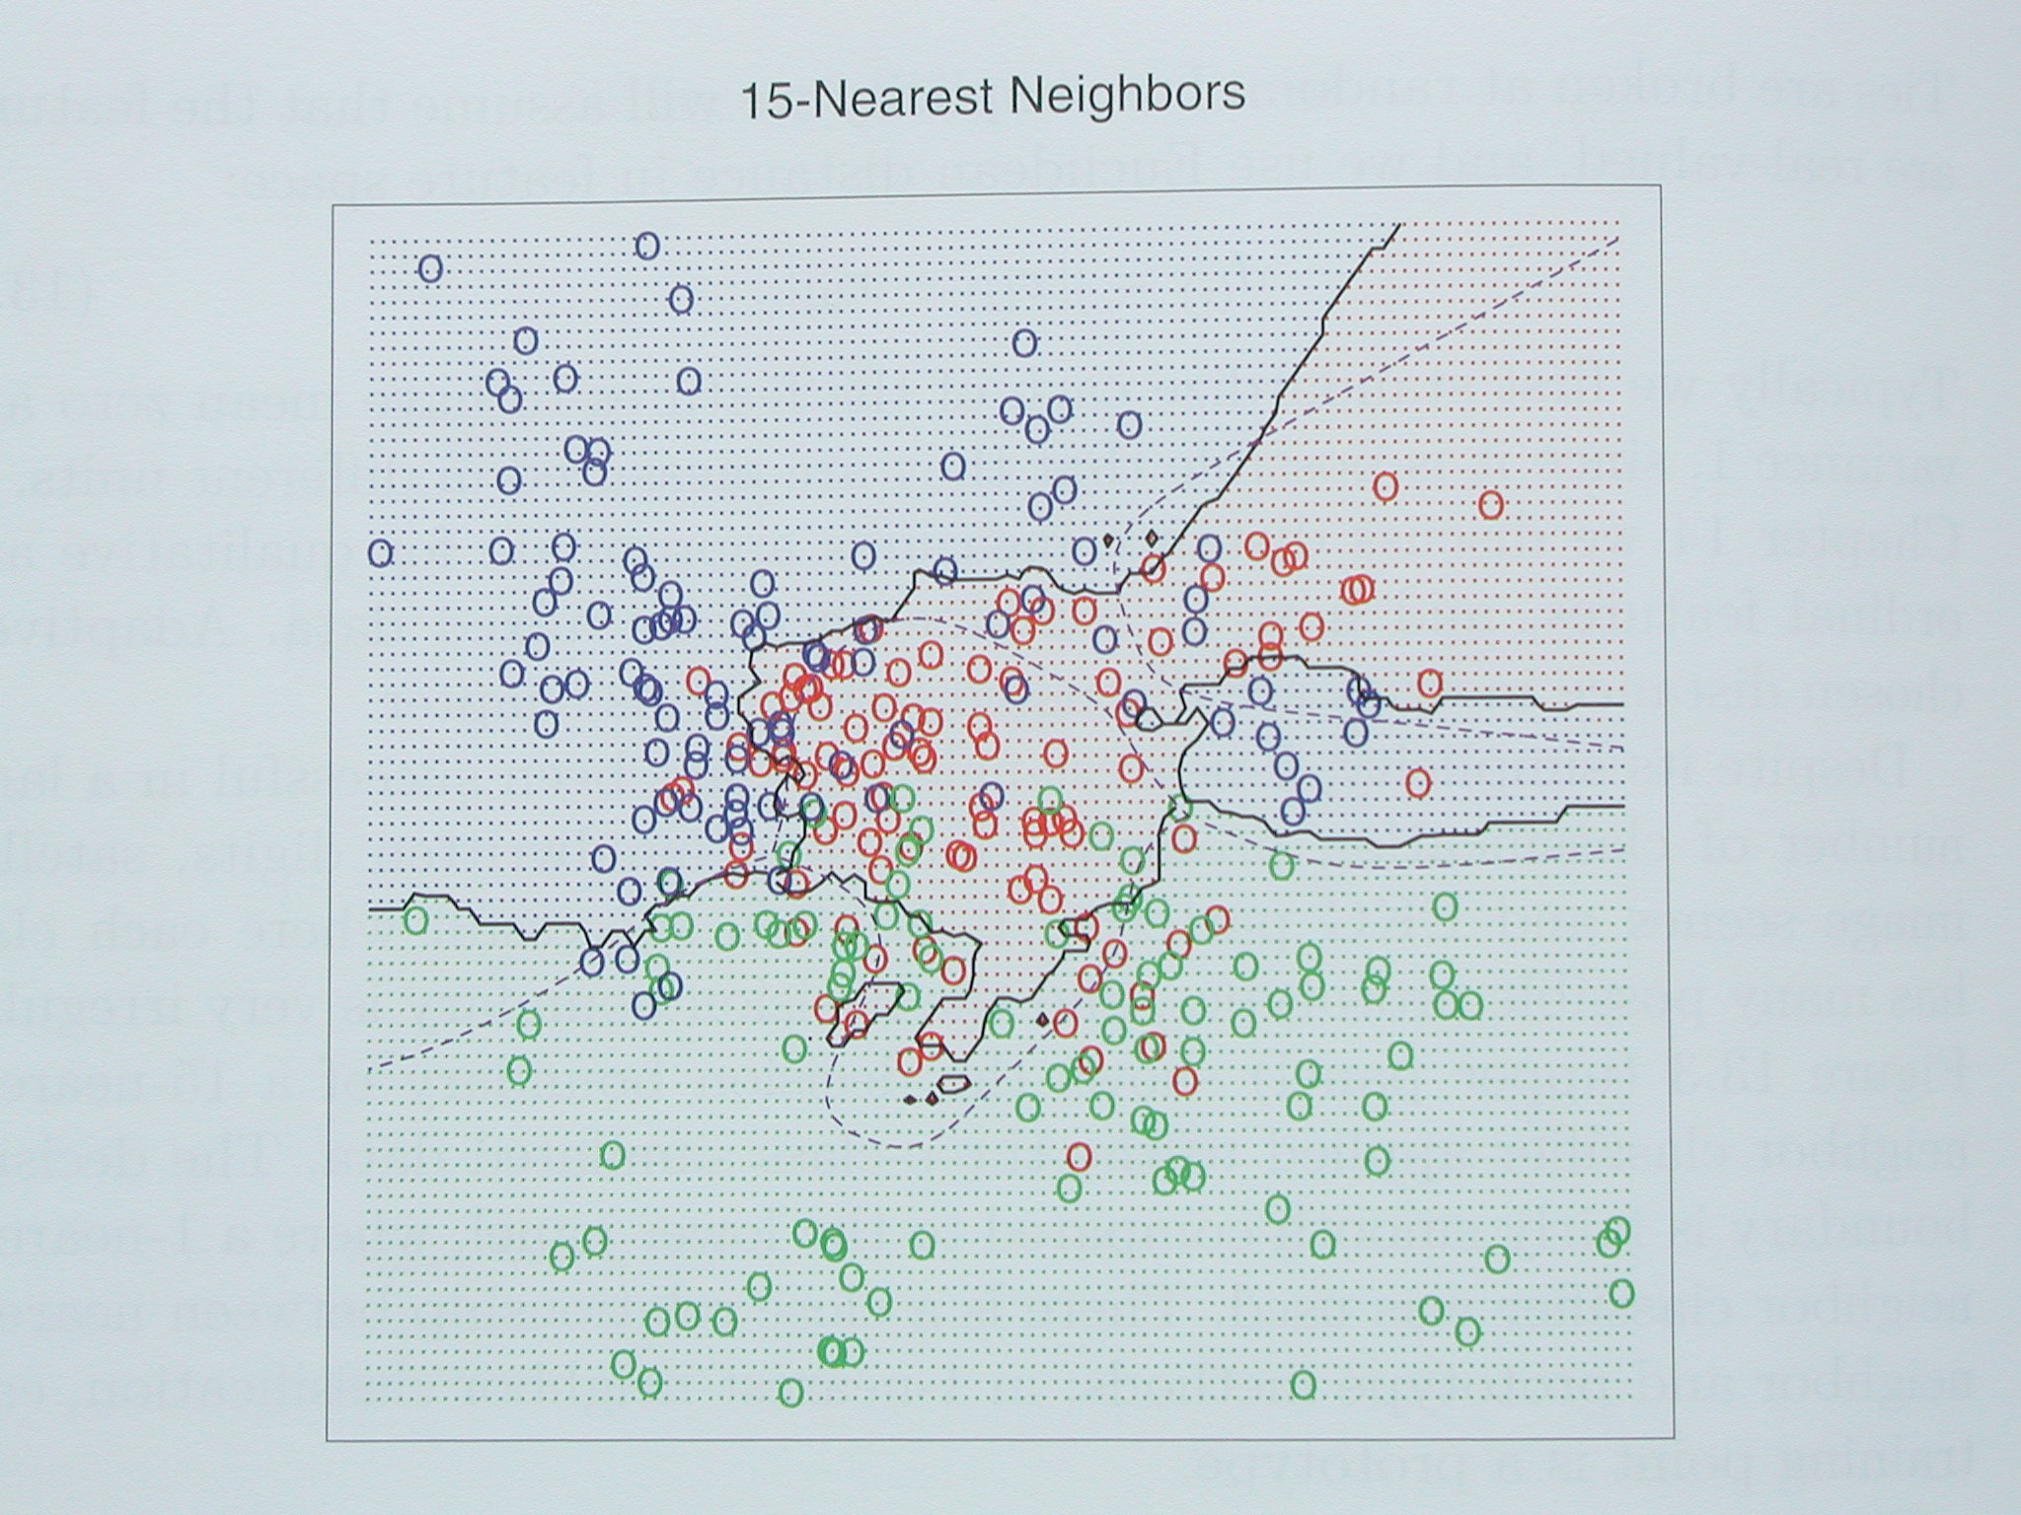
kNN Decision Boundaries
k=1 Decision Boundary
Looks complex
Overfitting?
What if we were to increase k?
K=15 Decision boundary

Slide 19
kNN Decision Boundaries
k=1 Decision Boundary
Looks complex
Overfitting?
What if we were to increase k?
K=15 Decision boundary
Smoother boundaries

Slide 20
kNN Decision Boundaries
k=1 Decision Boundary
Looks complex
Overfitting?
What if we were to increase k?
K=15 Decision boundary
Smoother boundaries
Generalizes better on unseen data

Slide 21
kNN Decision Boundaries
k=1 Decision Boundary
Looks complex
Overfitting?
What if we were to increase k?
K=15 Decision boundary
Smoother boundaries
Generalizes better on unseen data
What makes the boundaries smoother?

Slide 22
kNN Decision Boundaries
k=1 Decision Boundary
Looks complex
Overfitting?
What if we were to increase k?
K=15 Decision boundary
Smoother boundaries
Generalizes better on unseen data
What makes the boundaries smoother?
Let’s look at a two-class (binary) example

Slide 23
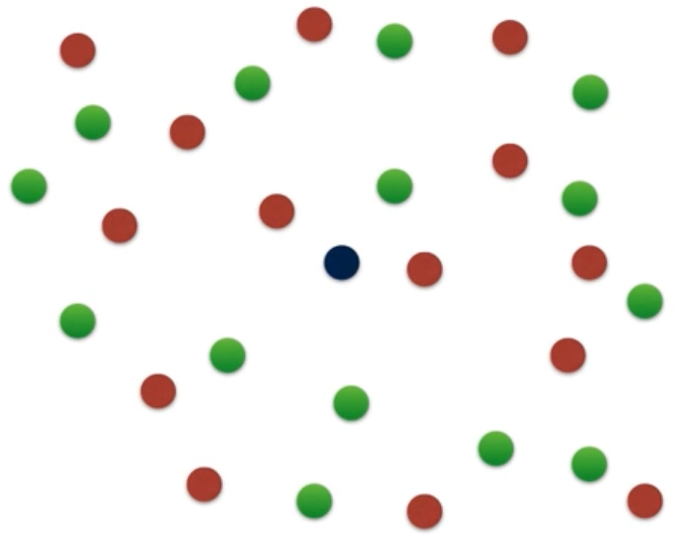
k-NN Graphical Example
Consider this two-dimensional dataset with points classified as Red or Green

Slide 24
k-NN Graphical Example
Consider this two-dimensional dataset with points classified as Red or Green
We want to Classify this point

Slide 25
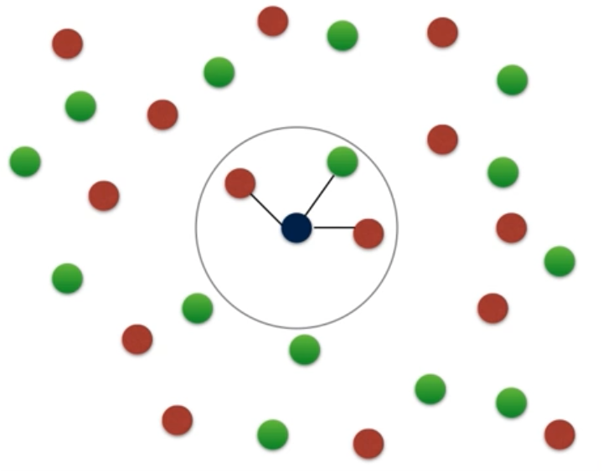
k-NN Graphical Example
Consider this two-dimensional dataset with points classified as Red or Green
We want to Classify this point
If we consider k=3 neighbors

Slide 26
k-NN Graphical Example
Consider this two-dimensional dataset with points classified as Red or Green
We want to Classify this point
If we consider k=3 neighbors
Measured by some distance
d

Slide 27
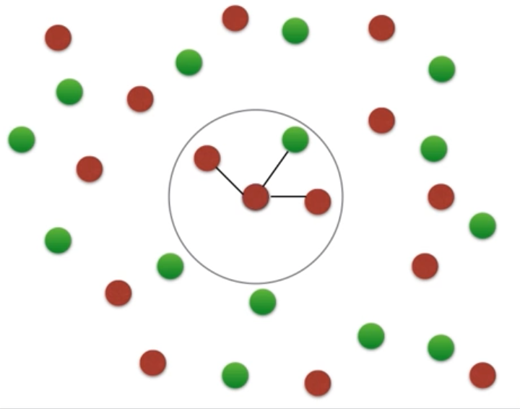
k-NN Graphical Example
Consider this two-dimensional dataset with points classified as Red or Green
We want to Classify this point
If we consider k=3 neighbors
Measured by some distance
The point is classified as Red

Slide 28
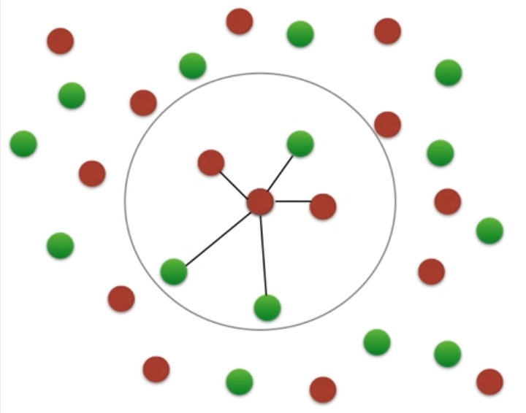
k-NN Graphical Example
Consider this two-dimensional dataset with points classified as Red or Green
We want to Classify this point
If we consider k=3 neighbors
Measured by some distance
The point is classified as Red
If we consider k=5 neighbors

Slide 29
k-NN Graphical Example
Consider this two-dimensional dataset with points classified as Red or Green
We want to Classify this point
If we consider k=3 neighbors
Measured by some distance
The point is classified as Red
If we consider k=5 neighbors
Measured by some distance
d

Slide 30
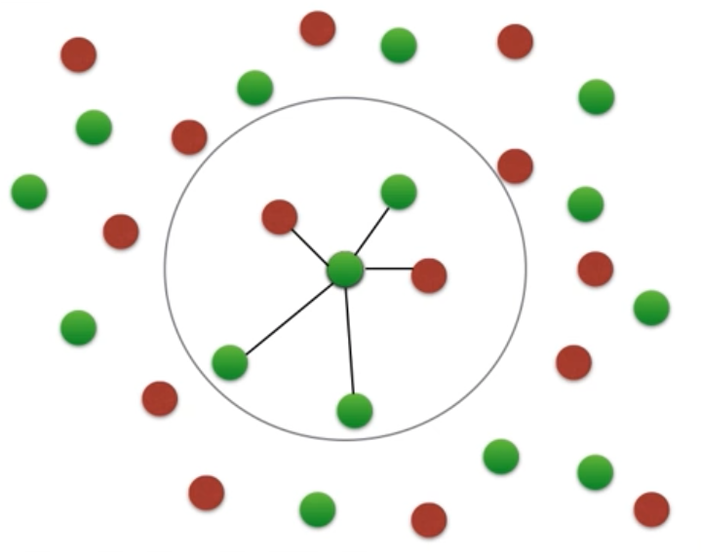
k-NN Graphical Example
Consider this two-dimensional dataset with points classified as Red or Green
We want to Classify this point
If we consider k=3 neighbors
Measured by some distance
The point is classified as Red
If we consider k=5 neighbors
Measured by some distance
The point is classified as Green

Slide 31
k-NN Graphical Example
Consider this two-dimensional dataset with points classified as Red or Green
We want to Classify this point
If we consider k=3 neighbors
Measured by some distance
The point is classified as Red
If we consider k=5 neighbors
Measured by some distance
The point is classified as Green
So, how do we know what k to choose?

Slide 32
How to choose “k”
Odd k (often 1, 3, or 5):
Avoids problem of breaking ties (in a binary classifier)
Large k:
Less sensitive to noise (particularly class noise)
Better probability estimates for discrete classes
Larger training sets allow larger values of k
Small k:
Captures fine structure of problem space better
May be necessary with small training sets
Balance between large and small k

Slide 33
kNN distance problem
Problem:
What if the input represents weight in milligrams?
Then small differences in physical weight dimension have a huge effect on distances, overwhelming other features
Should really correct for these arbitrary “scaling” issues
This leads to Standard Scaling
Rescale weights so that standard deviation = 1
o
o
o
o
o
o
o
o
o
o
o
o
o
bad
o
o
o
o
o
attribute_2
o
+
attribute_2
o
o
o
+
+
+
+
+
+
+
+
+
+
+
+
+
+
+
+
+
weight (lb)
weight (mg)

Slide 34
More kNN Details
Nonparametric - makes no explicit assumptions about the underlying distribution of the input
Instance/memory-based learning means that this algorithm doesn’t explicitly learn a model. Instead, it chooses to memorize the training instances which are subsequently used as “knowledge” for the prediction phase
Learns arbitrarily complicated decision boundaries
Lazy learner - method that generalizes data in the testing (deployment) phase, rather than during the training phase – designed to be continuously updating as new data comes in
A benefit of lazy learning is that it can quickly adapt to changes,
Think Netflix recommendations, new options are appearing constantly so have a static training set it’s really valuable.
Very fast training time, but very slow prediction (has to search for the nearest neighbors)

Slide 35
Advantages of k-NN
Simple and fast to deploy
Little to no training time
Easy to interpret/explain
Naturally handles multiclass datasets
Non-parametric
Does not assume any probability distributions on the input data

Slide 36
Disadvantages of k-NN
Storage of model takes a lot of disk space (contains entire training dataset)
Curse of Dimensionality - often works best with 25 or fewer dimensions
There is little difference between the nearest and farthest neighbor in high dimensional data (starts to normalize to 1)
Computationally expensive predictions (large search problem to find nearest neighbors)
Might be impractical in industry settings
Need to normalize - suffers from skewed class distributions
If one type of category occurs much more than another, classifying an input will be more biased towards that one category (dominates the majority vote since it is more likely to be neighbors with the input)

Slide 37
kNN Exercise
Switch to Code

Slide 38
Understanding Probability Classifiers
To be able to unpack the probability classifiers, we need a good grasp on the following topics
Random variables
Distributions
Continuous
Discrete
Statistical Independence
Probability
Conditional Probability
Joint Probability
Marginal Probability

Slide 39
Random Variables
A random variable is a random number determined by chance, or more formally, drawn according to a probability distribution which specifies the probability that its value falls in any given interval.
Discrete Random Variable
Taking any of a specified finite or countable list of values, endowed with a probability mass function characteristic of the random variable's probability distribution
Continuous
Taking any numerical value in an interval or collection of intervals, via a probability density function that is characteristic of the random variable's probability distribution

Slide 40
Random Variables
Why do we care about Random Variables?
Our goal is to predict the target/class
We are not given the true (presumably deterministic) function
We are only given observations
Uncertainty arises through:
Noisy measurements
Finite size of data sets
Ambiguity: The word “bank” can mean (1) a financial institution, (2) the side of a river,or (3) tilting an airplane. Which meaning was intended, based on the words that appear nearby?
Probability theory provides a consistent framework for the quantification and manipulation of uncertainty
Allows us to make optimal predictions given all the information available to us, even though that information may be incomplete or ambiguous

Slide 41
Probability
Probabilities assign numbers to possibilities
A probability needs to satisfy three properties (Kolmogorov, 1956):
A probability must be nonnegative
The sum of the probabilities across all events in the entire sample space must be 1
For any two mutually exclusive events, the probability that one or the other occurs is the sum of their individual probabilities
For example, the probability that a fair six-sided die comes up 3 OR 4 is 1/6 + 1/6 = 2/6.

Slide 42
Probability Distributions
A probability distribution is simply a list of all possible events and their corresponding probabilities
There are two kinds of probability distributions
Discrete Distribution:
Probability of heads or tails
Continuous Distribution:
Probabilities of people’s heights

Slide 43
Discrete Probability Distribution
When the sample space consists of discrete outcomes (e.g., heads or tails), the probability distribution is a list of probabilities of the outcomes
The probability of a discrete outcome is called a probability mass
The sum of the probability masses across the sample space must be 1

Slide 44
Discrete Probability Example
Example
Consider the simple experiment of tossing a coin three times. Let X = number of times the coin comes up heads. The 8 possible elementary events and the corresponding values for X are:
Elementary Event | Count of Heads (X)
TTT | 0
TTH | 1
THT | 1
HTT | 1
THH | 2
HTH | 2
HHT | 2
HHH | 3

Slide 45
Discrete Probability Example
Example
Therefore, the probability distribution for the number of heads occurring in three coin tosses is
Count of Heads (X) | p(x) | F(x)
0 | 1/8 | 1/8
1 | 3/8 | 4/8
2 | 3/8 | 7/8
3 | 1/8 | 1

Slide 46
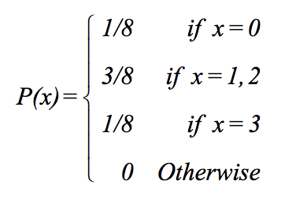
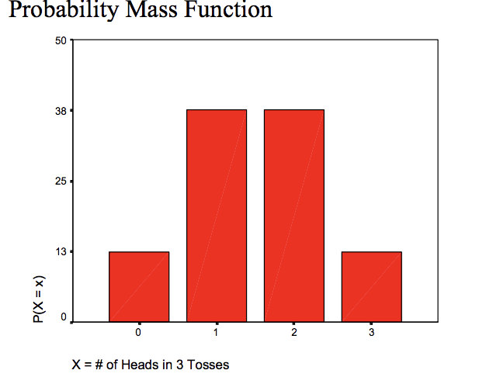
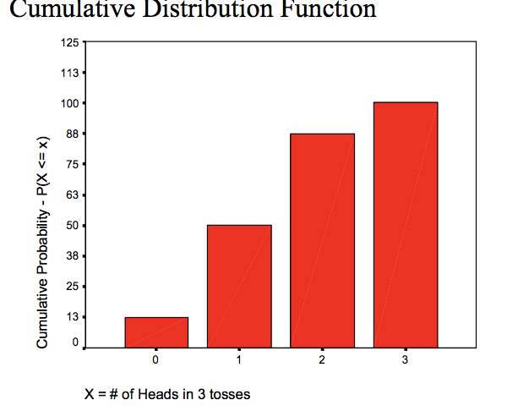
Discrete Probability Example
Count of Heads (X) | p(x) | F(x)
0 | 1/8 | 1/8
1 | 3/8 | 4/8
2 | 3/8 | 7/8
3 | 1/8 | 1

Slide 47
Continuous Probability Distribution
When the sample space consists of continuous outcomes (ex: people’s heights) we cannot use probability mass for a specific outcome.
Why not?

Slide 48
Continuous Probability Distribution – Probability Density
When the sample space consists of continuous outcomes (ex: people’s heights) we cannot use probability mass for a specific outcome.
Why not?
Because the probability mass for a specific outcome will be zero
In other words, the probability of someone’s height being exactly 67.2141390842076153…
Instead, we can:
Discretize the space into a finite set of mutually exclusive and exhaustive intervals
Calculate the probability mass in each interval
Use the ratio of probability mass to interval width
This ratio is called the Probability Density

Slide 49
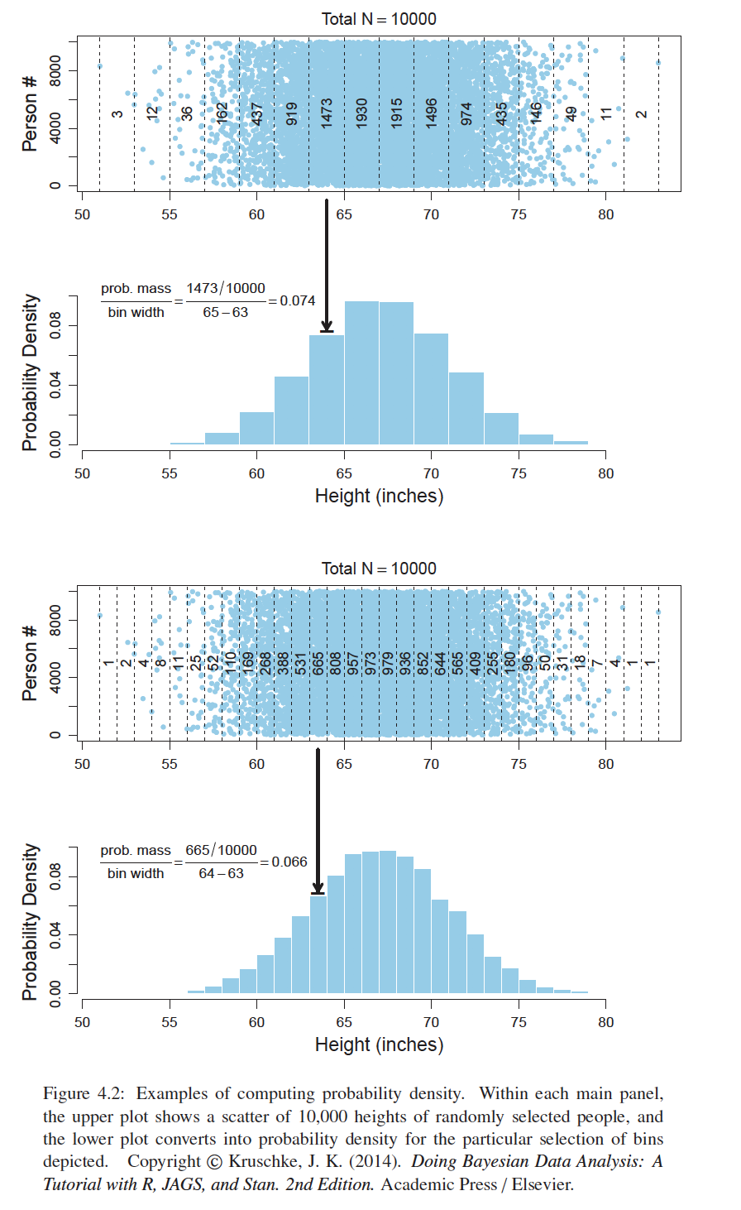
Probability Density
The top panel of this figure shows the discretized intervals and probability mass in each interval
The second panel shows the probability density
The third panel shows the narrower intervals and probability mass in each interval
The bottom panel shows the probability density corresponding to the more narrow intervals
Generally, the skinnier the intervals are, the more accurate the probability density is

Slide 50
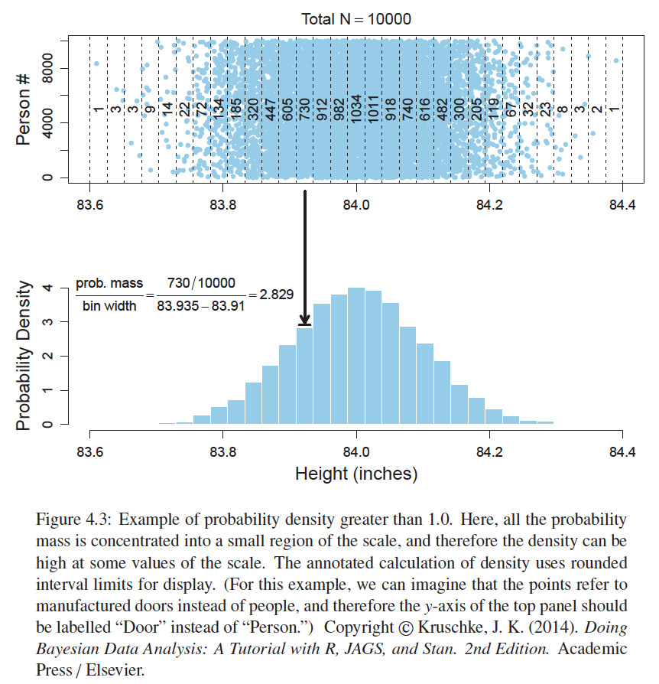
Probability Density
While probability mass cannot exceed 1, probability densities can
The upper panel of this figure shows that most of the probability mass is concentrated around 84
Consequently, the probability density near 84 exceeds 1.0, as shown in the lower panel
This simply means that there is a high concentration of probability mass relative to the width of the interval

Slide 51
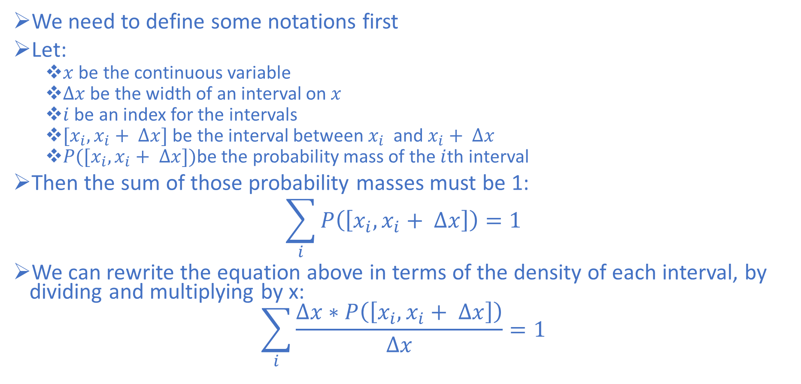
Properties of Probability Density Functions
We need to define some notations first
Let:
$x$ be the continuous variable
$Δx$ be the width of an interval on $x$
$i$ be an index for the intervals
$[x_{i},x_{i}+ ∆x]$ be the interval between $x_{i}$ and $x_{i}+ ∆x$
$P([x_{i},x_{i}+ ∆x])$be the probability mass of the $i$th interval
Then the sum of those probability masses must be 1:
$$\sum_{i}{P\left(\left[x_{i},x_{i}+ ∆x\right]\right)=1}$$
We can rewrite the equation above in terms of the density of each interval, by dividing and multiplying by x:
$$\sum_{i}{\frac{∆x∗P\left(\left[x_{i},x_{i}+ ∆x\right]\right)}{∆x}=1}$$

Slide 52
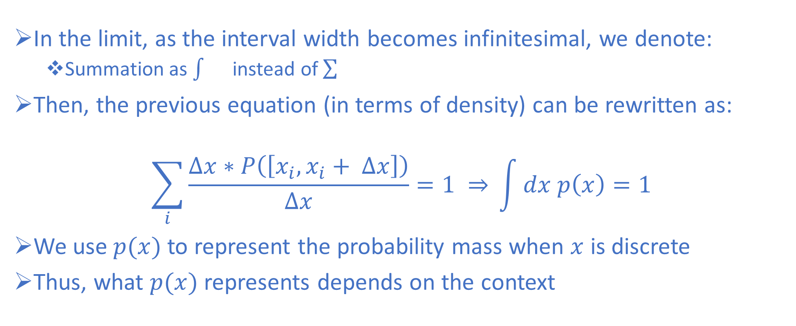
Properties of Probability Density Functions
In the limit, as the interval width becomes infinitesimal, we denote:
Summation as instead of
Then, the previous equation (in terms of density) can be rewritten as:
$$\sum_{i}{\frac{∆x∗P\left(\left[x_{i},x_{i}+ ∆x\right]\right)}{∆x}=1 ⇒} \int{dx p\left(x\right)=1}$$
We use$p(x)$to represent the probability mass when $x$ is discrete
Thus, what $p(x)$represents depends on the context

Slide 53
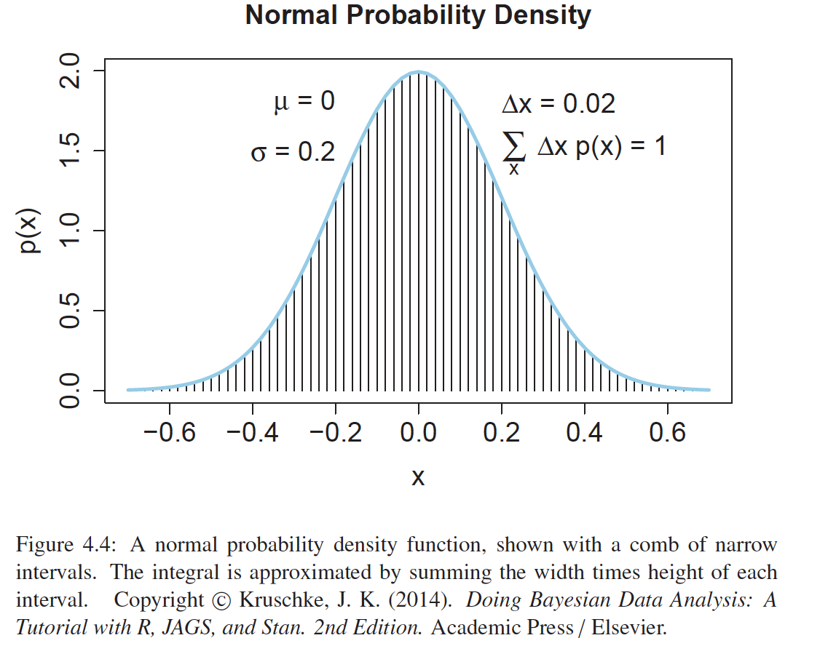
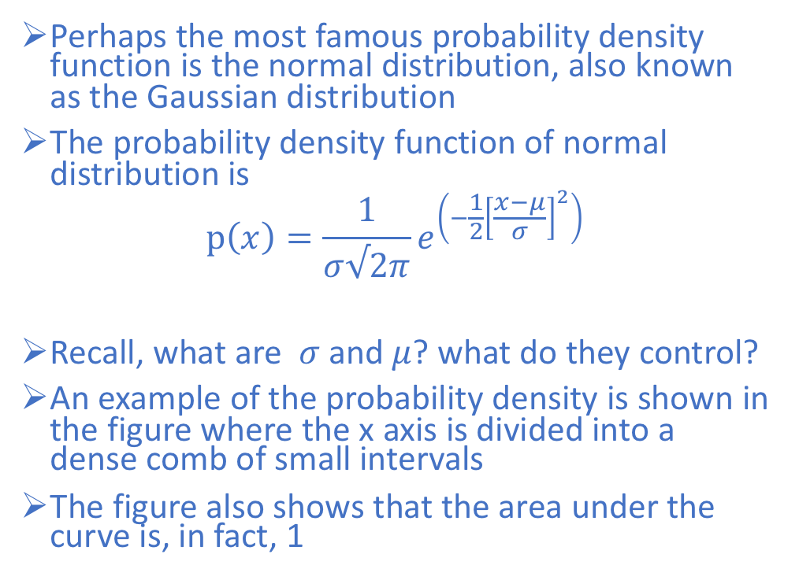
The Normal Probability Density Functions
Perhaps the most famous probability density function is the normal distribution, also known as the Gaussian distribution
The probability density function of normal distribution is
$$p\left(x\right)=\frac{1}{σ√2π}e^{\left(−\frac{1}{2}{\left[\frac{x−μ}{σ}\right]}^{2}\right)}$$
Recall, what are $σ$and $μ$? what do they control?
An example of the probability density is shown in the figure where the x axis is divided into a dense comb of small intervals
The figure also shows that the area under the curve is, in fact, 1

Slide 54
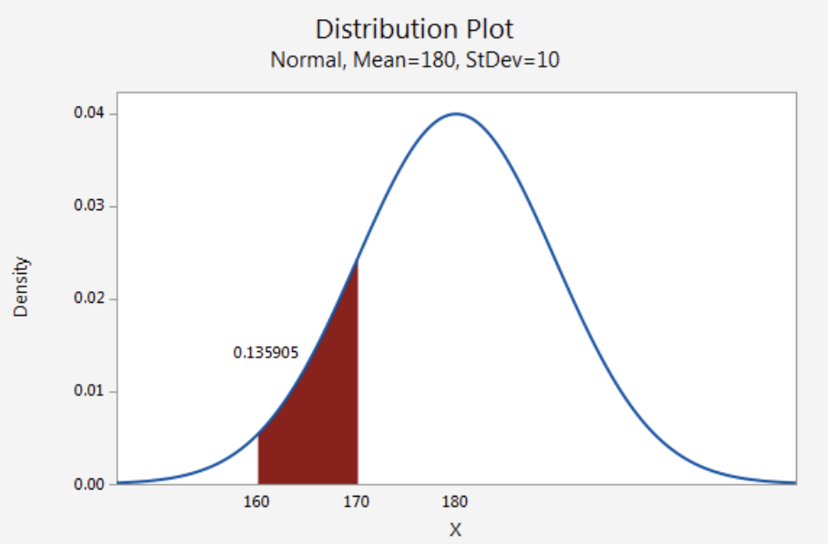
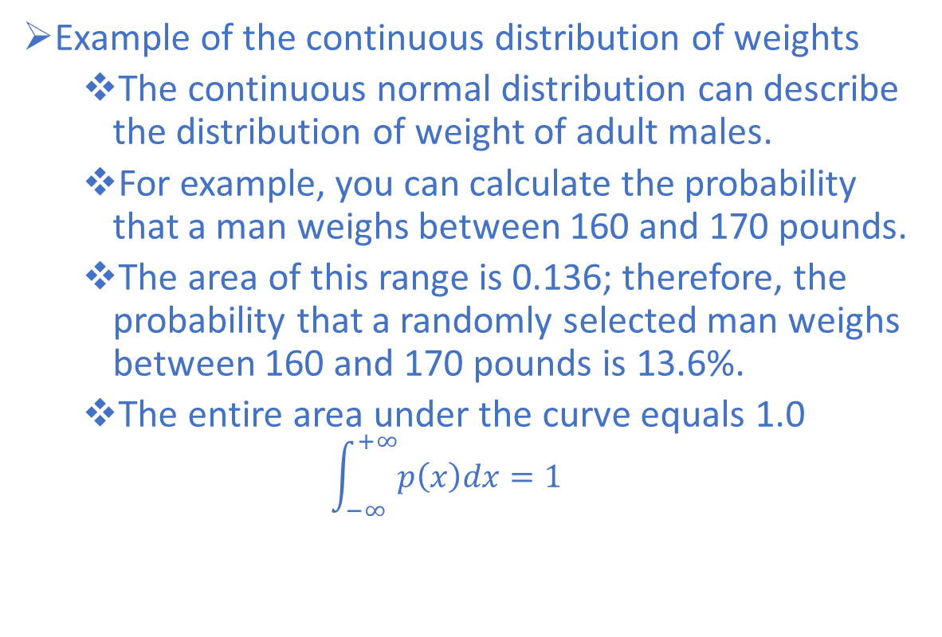
Example - Continuous Normal Distribution
Example of the continuous distribution of weights
The continuous normal distribution can describe the distribution of weight of adult males.
For example, you can calculate the probability that a man weighs between 160 and 170 pounds.
The area of this range is 0.136; therefore, the probability that a randomly selected man weighs between 160 and 170 pounds is 13.6%.
The entire area under the curve equals 1.0
$$\int_{−∞}^{+∞}{p\left(x\right)dx=1}$$
Notes:
However, the probability that X is exactly equal to some value is always zero because the area under the curve at a single point, which has no width, is zero.
For example, the probability that a man weighs exactly 190 pounds to infinite precision is zero.
You could calculate a nonzero probability that a man weighs more than 190 pounds, or less than 190 pounds, or between 189.9 and 190.1 pounds, but the probability that he weighs exactly 190 pounds is zero.

Slide 55
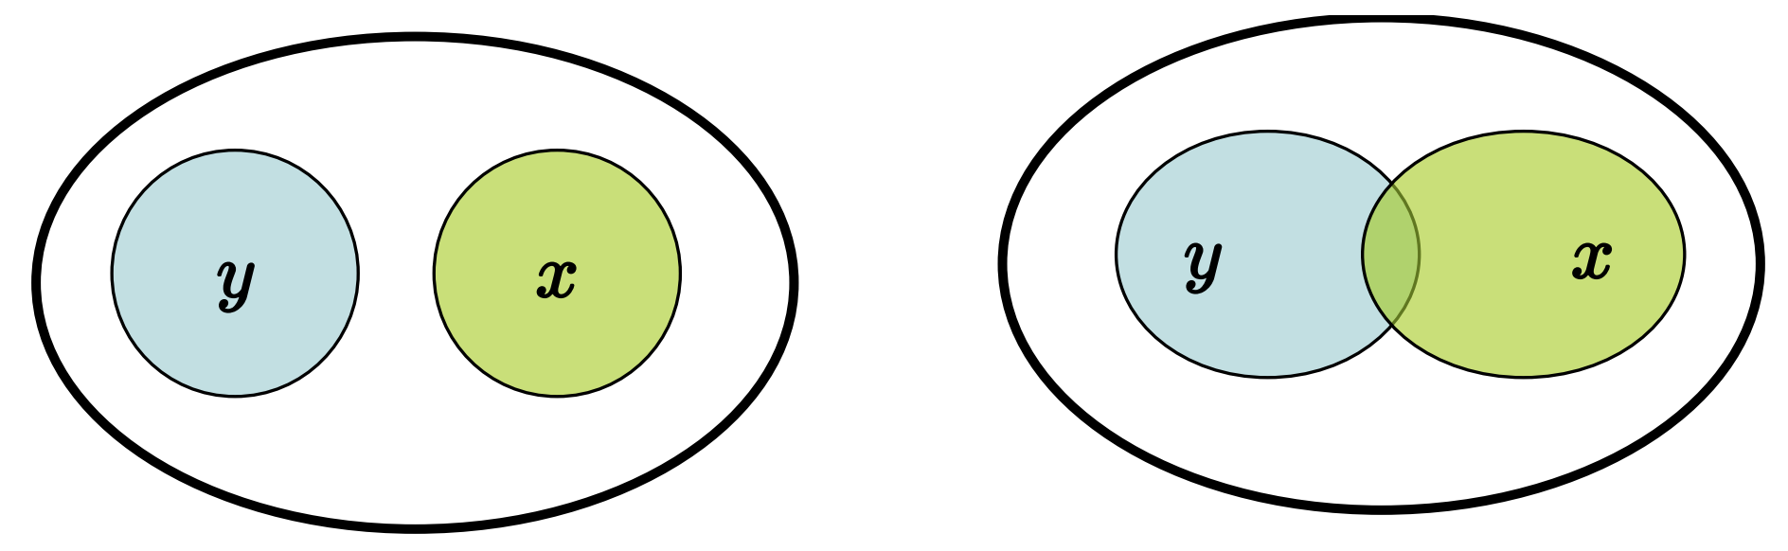
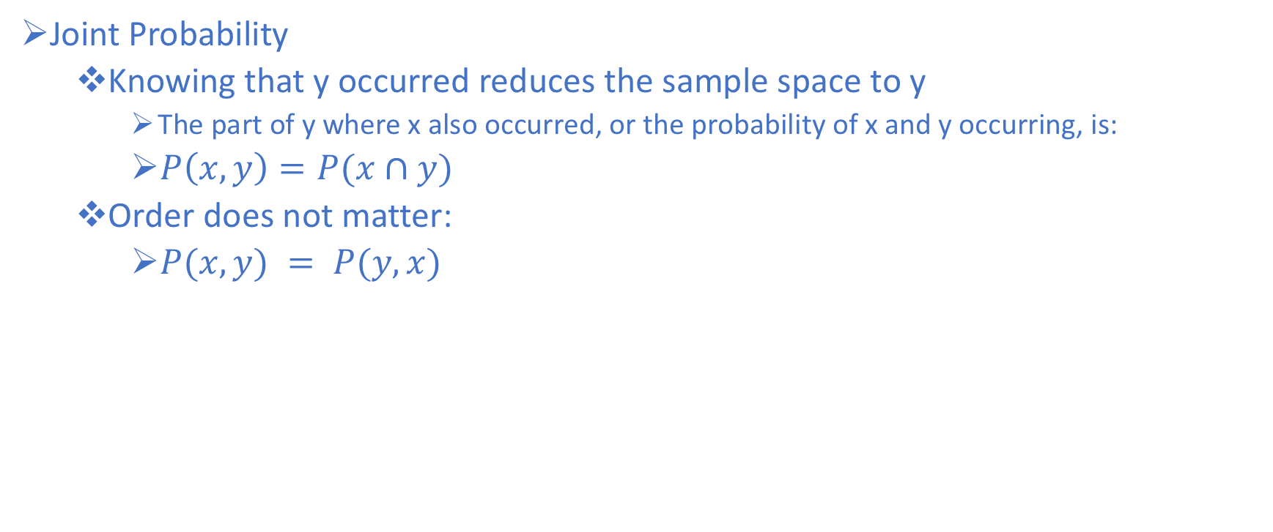
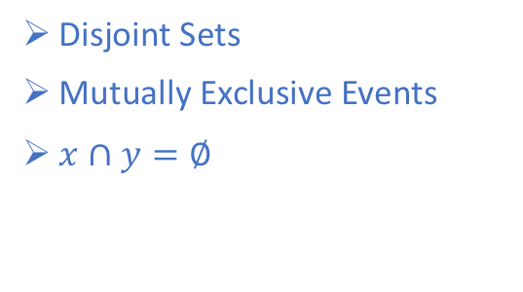
Joint Probability
Joint Probability
Knowing that y occurred reduces the sample space to y
The part of y where x also occurred, or the probability of x and y occurring, is:
$P\left(x,y\right)=P(x∩y)$
Order does not matter:
$P(x,y) = P(y,x)$
Disjoint Sets
Mutually Exclusive Events
$x∩y=∅$
Intersecting sets

Slide 56
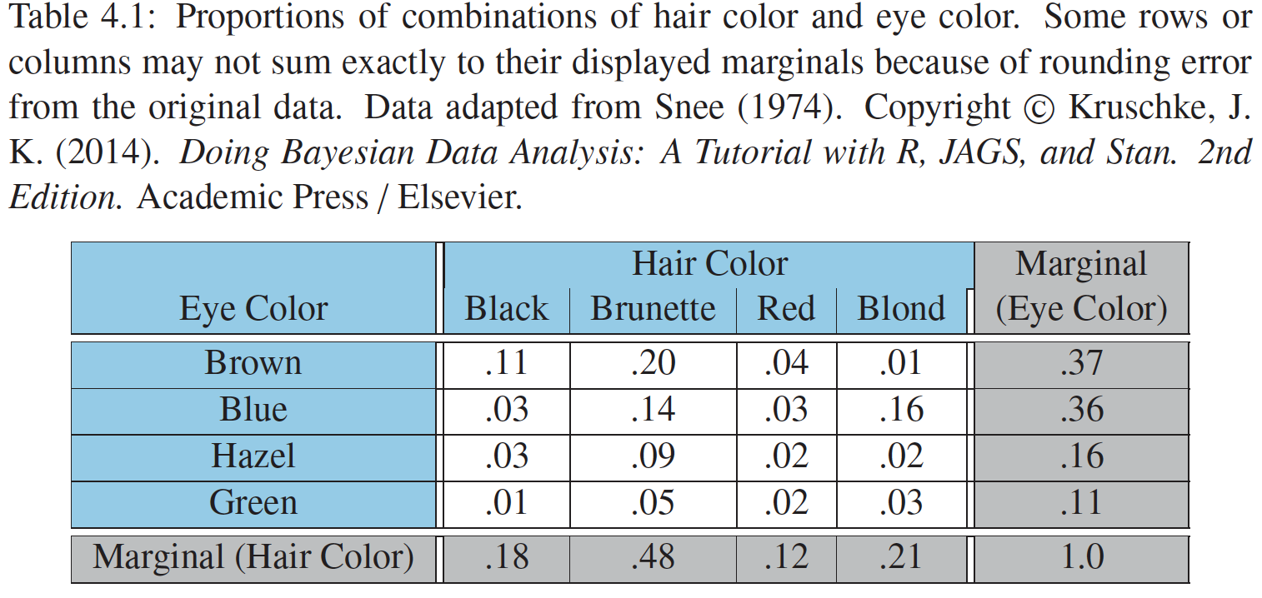
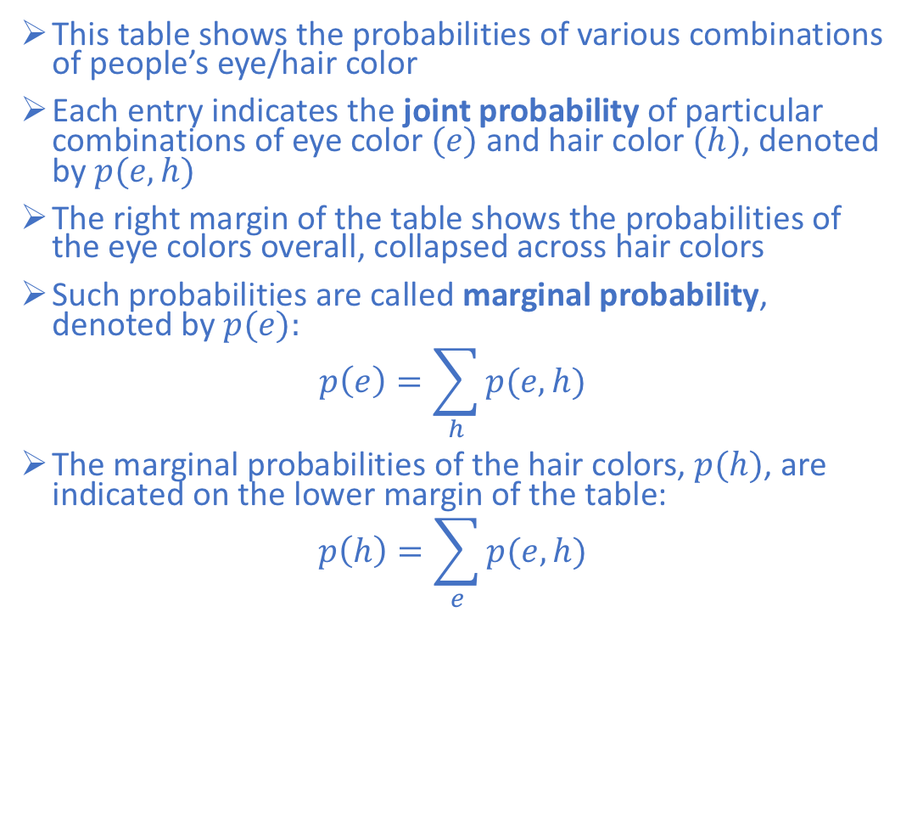
Joint Probability and Marginal Probability
This table shows the probabilities of various combinations of people’s eye/hair color
Each entry indicates the joint probability of particular combinations of eye color $(e)$and hair color $(h)$, denoted by $p(e,h)$
The right margin of the table shows the probabilities of the eye colors overall, collapsed across hair colors
Such probabilities are called marginal probability, denoted by $p(e):$
$$p\left(e\right)=\sum_{h}{p(e,h)}$$
The marginal probabilities of the hair colors, $p(h)$, are indicated on the lower margin of the table:
$$p\left(h\right)=\sum_{e}{p(e,h)}$$

Slide 57
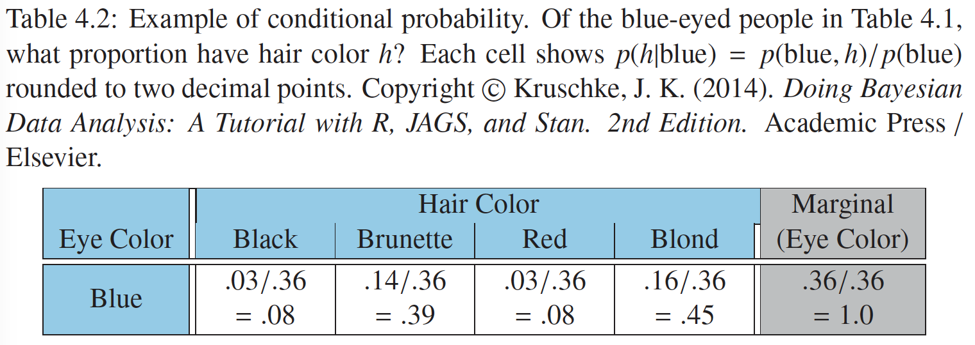
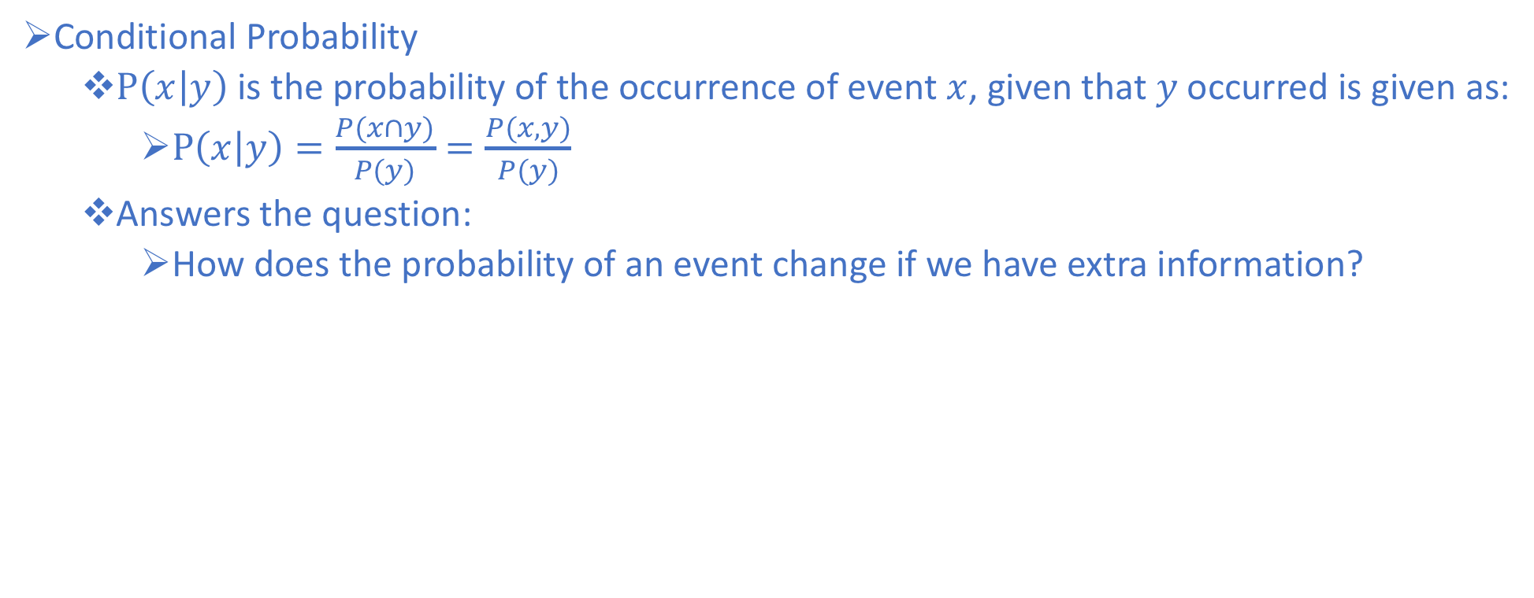
Conditional Probability
Conditional Probability
$P\left(x | y\right)$is the probability of the occurrence of event $x$, given that $y$ occurred is given as:
$P\left(x | y\right)=\frac{P(x∩y)}{P(y)}=\frac{P(x,y)}{P(y)}$
Answers the question:
How does the probability of an event change if we have extra information?

Slide 58
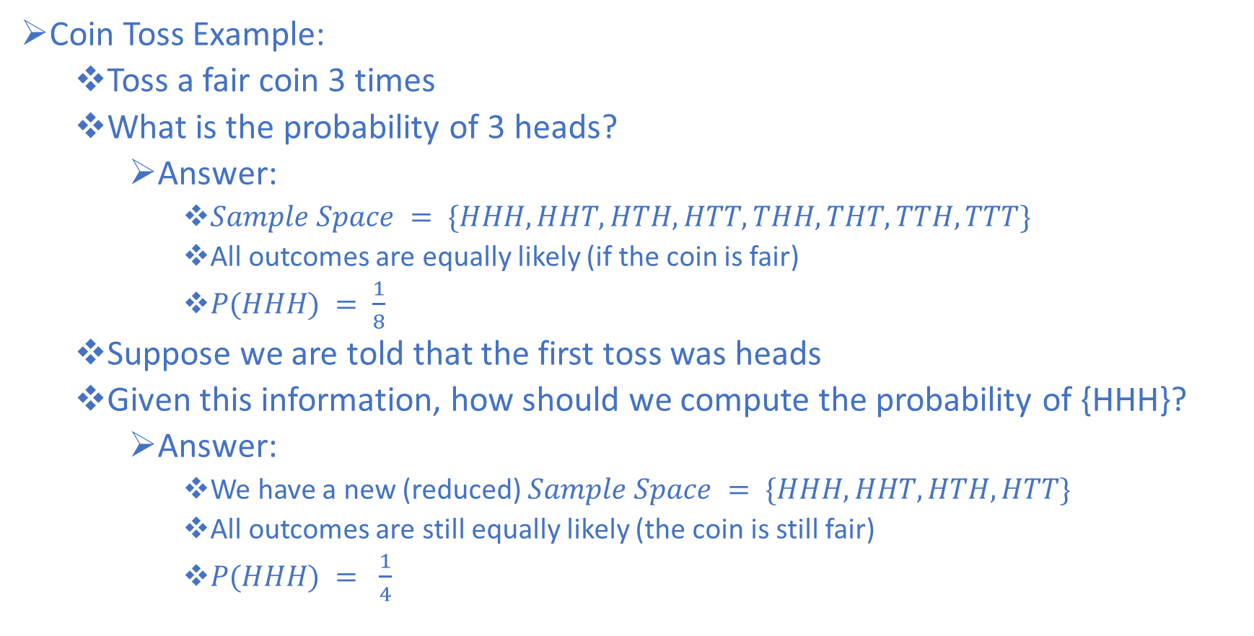
Conditional Probability Example
Coin Toss Example:
Toss a fair coin 3 times
What is the probability of 3 heads?
Answer:
$Sample Space = \{HHH, HHT, HTH, HTT, THH, THT, TTH, TTT\}$
All outcomes are equally likely (if the coin is fair)
$P(HHH) = \frac{1}{8}$
Suppose we are told that the first toss was heads
Given this information, how should we compute the probability of {HHH}?
Answer:
We have a new (reduced) $Sample Space = \{HHH, HHT, HTH, HTT\}$
All outcomes are still equally likely (the coin is still fair)
$P(HHH) = \frac{1}{4}$

Slide 59
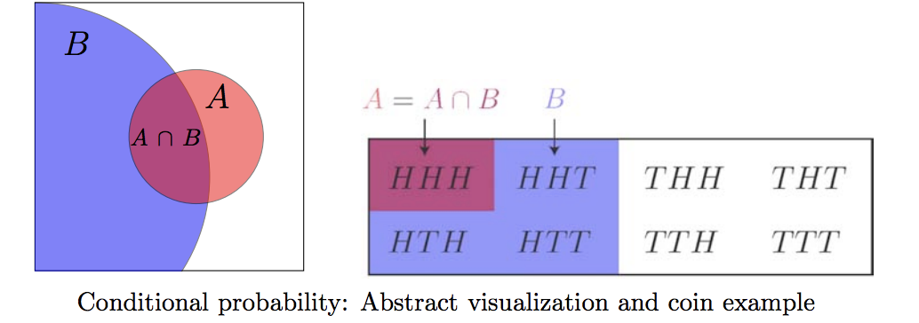
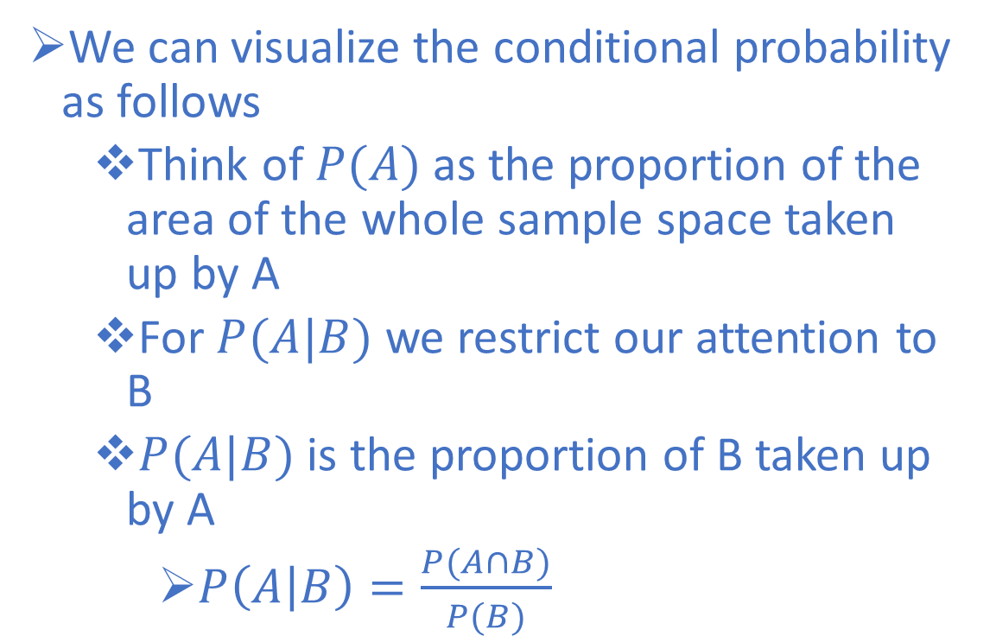
Conditional Probability Example
We can visualize the conditional probability as follows
Think of $P(A)$as the proportion of the area of the whole sample space taken up by A
For $P(A|B)$ we restrict our attention to B
$P(A|B)$ is the proportion of B taken up by A
$P\left(A | B\right)=\frac{P(A∩B)}{P(B)}$

Slide 60
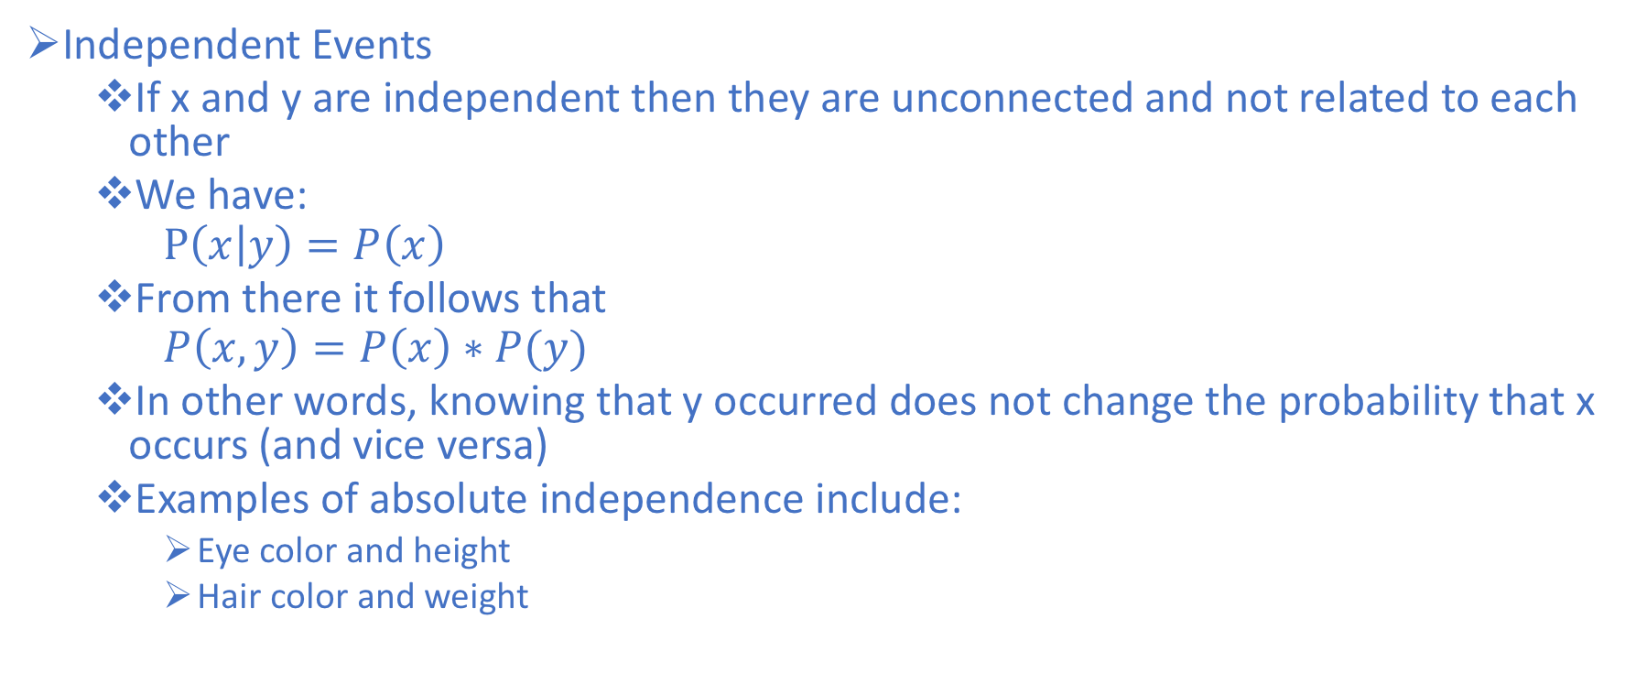
Statistical Independence
Independent Events
If x and y are independent then they are unconnected and not related to each other
We have:
$$P\left(x | y\right)=P\left(x\right)$$
From there it follows that
$$P\left(x,y\right)=P\left(x\right)∗P(y)$$
In other words, knowing that y occurred does not change the probability that x occurs (and vice versa)
Examples of absolute independence include:
Eye color and height
Hair color and weight

Slide 61
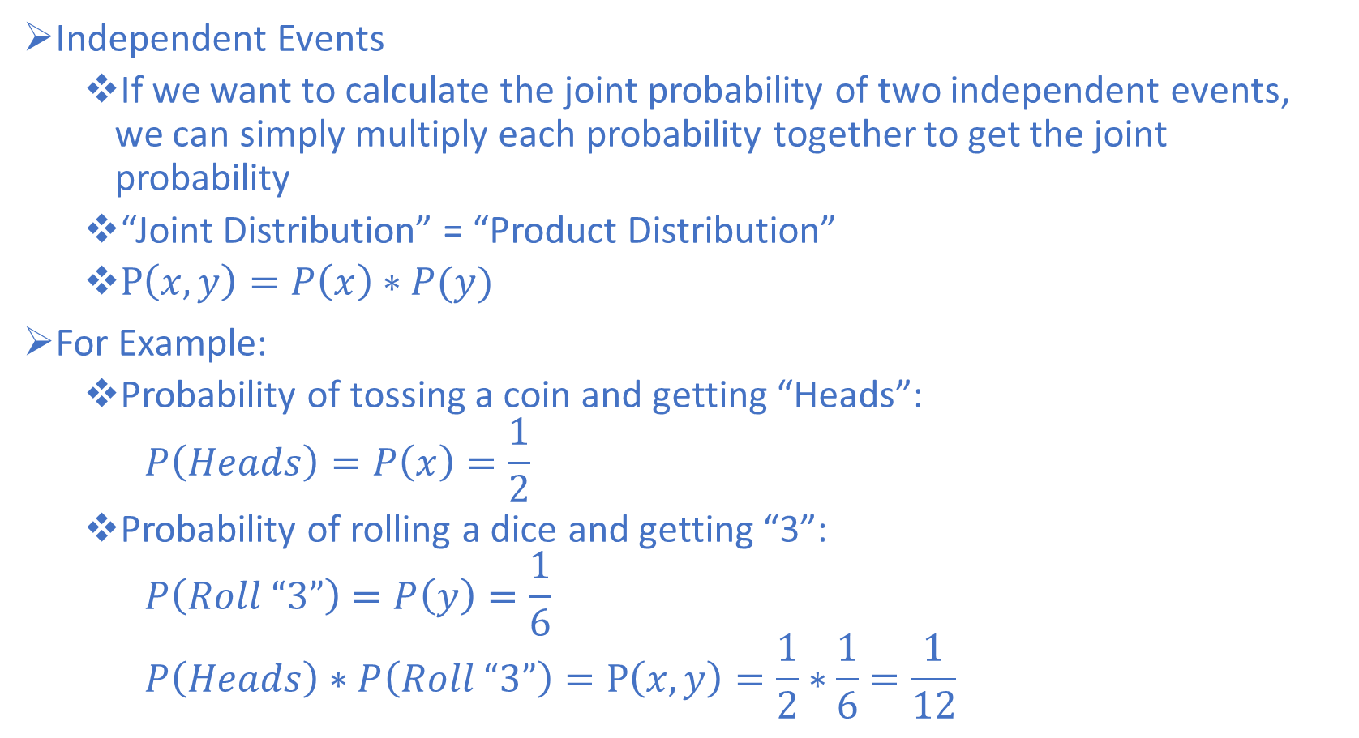
Statistical Independence Example
Independent Events
If we want to calculate the joint probability of two independent events, we can simply multiply each probability together to get the joint probability
“Joint Distribution” = “Product Distribution”
$P\left(x,y\right)=P\left(x\right)∗P(y)$
For Example:
Probability of tossing a coin and getting “Heads”:
$$P\left(Heads\right)=P\left(x\right)=\frac{1}{2}$$
Probability of rolling a dice and getting “3”:
$$P\left(Roll “3”\right)=P\left(y\right)=\frac{1}{6}$$
$$P\left(Heads\right)∗P\left(Roll “3”\right)=P\left(x,y\right)=\frac{1}{2}∗\frac{1}{6}=\frac{1}{12}$$

Slide 62
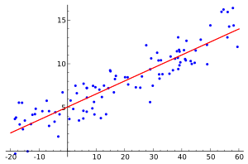
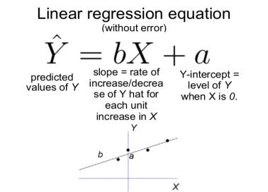
Regression Review
Linear regression finds the straight line, called the least squares regression line or LSRL, that best represents observations in a data set. Suppose Y is a dependent variable, and X is an independent variable. Then, the equation for the regression line would be: ŷ = b₀ + b₁x
Notes:
ordinate and abscissa (Y and X)

Slide 63
Assumptions
Linear relationship between dependent and independent - Plot
Multicollinearity – occurs when independent variables are not independent – checked with VIF
Auto-correlation – Occurs when residuals are not independent from each other – stock prices example- Durbin-Watson d tests
Homoscedasticity – Error term along the regression line are equal – Scatter Plot – can convert the dependent variable.

Slide 64
Regression
Works best with numeric/continuous data to increase the inferential power
We are trying to model or explain the relationship between a single variable Y (response, output, dependent) and one or more X₁….. (predictor, input, independent, explanatory, regessors..etc.)
Y must be a continuous variable but X categorical, continuous,
Centering (scale/Zscores) variables so that the predictors have mean 0, is often recommended. The intercept term is then interpreted as the expected value of Yi when the predictor values are set to their means. Otherwise, the intercept is interpreted as the expected value of Yi when the predictors are set to 0, which may not be a realistic or interpretable situation (e.g. what if the predictors were height and weight?).

Slide 65
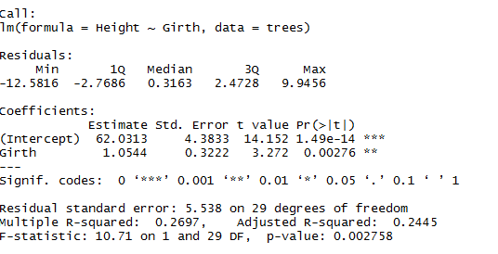
What Does r² (Coefficient of Determination) Mean?
This statistic quantifies the proportion of the variance of one variable “explained” (in a statistical sense, not a causal sense) by the other.
As an example at data set in R (.2697) = 27% of the variability in trunk Height is explained by Girth

Slide 66
R Regression Output: Coefficients
Formula Call?
Regression equation
Estimate?
Coefficients for the regression equation
Standard Error?
Measures the average amount that the coefficient estimates vary from the actual average value of our response variable, can be used to generate confidence intervals.
P value?
A small p-value indicates that it is unlikely we will observe a relationship between the predictor (Girth) and response (Height) variables due to chance, a p-value of .05 or less is considered statistical significant

Slide 67
R Regression Output
Residual Standard Error
The average amount that the response will deviate from the true regression line. Used to evaluate our model.
In our example we have a residual error of 5.538 in the predication of tree height. The average tree height is 76 meaning we could be off by roughly 7%.
Multiple R-squared?
Provides a measure of how well the model is fitting the actual data, percentage of variance explained by the predictors, ours example is 27%
No. of Stand Dev. coefficient is from zero. Estimate/Stand Error – larger is better

Slide 68
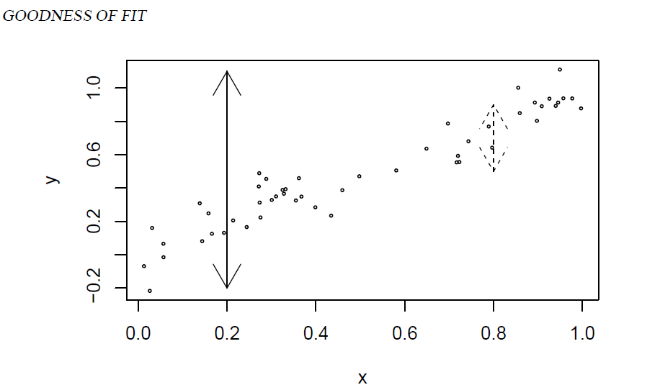
Visual

Slide 69
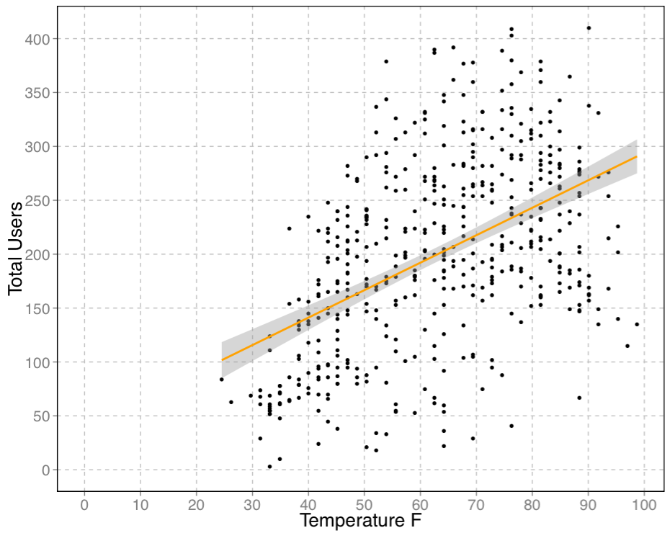
Bike Share Output

Slide 70
Another Definition: Functional Approximation
What is a functional approximation problem?
Target variable: Dependent: What we are trying to predict
Other Variables: Independent: Using to Predict
Functional approximation is a approach that uses the other variables we have access to approximate the dependent and does so through the function development
We will use regression and which assumes that we have a numeric target variable, for classification it’s often a bi-variate or class level variable

Slide 71
Assessment Measures
Assessing Regression Models: MSE, RMSE and MAE
MSE – The difference between the predicted values and the actual values squared
RSME – Same as above only the square root is taken to put the error back in terms of the dependent variable
Can also normalize the RSME to the range of the data in order to be able to compare RSME outputs that include different data ranges
MAE – The same approach only taking the absolute value instead of squaring

Slide 72
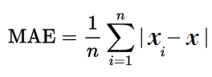
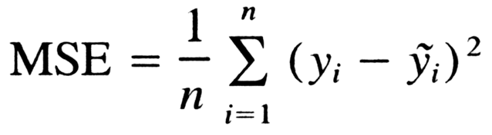
Equations
Notes:
Can also take the average of the X values vice the range to normalize the output

Slide 73
Linear Regression
Best used in situations where the data being deploy lacks a high level of complexity
Trains very fast but isn’t able to create complex decision boundaries when data is heterogeneous.
Also as compared to most ML approaches OLS does not have a built in function that can control for overfitting
However not all hope is lost, we can use forward stepwise regression – which we discussed in Intro to DS or
Ridge/Penalized Regression
Notes:
Recombining all the data and then running the algo again – haven’t done this before.

Slide 74
Regression
Said another way basic linear regression has a Prediction Accuracy Problem:
Has a low bias (overfitting) but a high variance
This can be improved by injecting some level of bias into the equation by reducing the impact of certain coefficients
This can improve overall accuracy by reducing variance
Draw Dart Board –
Another issue is interpretation – with a large number of predictor variables and large data sets it often hard to identify variable importance and explain model outcomes
Notes:
Recombining all the data and then running the algo again – haven’t done this before.

Slide 75
Regression and Sparsity
Often we have more features than observations in the world of big data
What type of problem is this?
So we strive to have Sparse models
What do we mean by Sparse?
Notes:
Small number of non-zero parameters

Slide 76
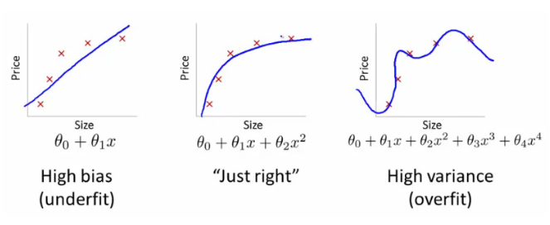
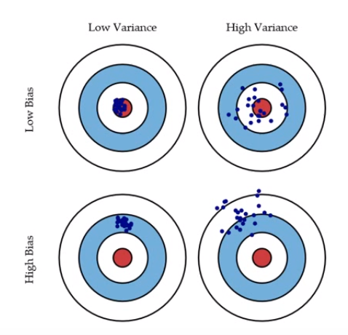
Bias Versus Variance

Slide 77
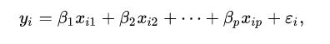
Ridge Regression
Injecting bias can be done through a regulator or utilization of a penalizing attribute. two common examples are Ridge and Lasso, let’s start with Ridge
Basic Regression Equation
Notes:
Recombining all the data and then running the algo again – haven’t done this before.

Slide 78
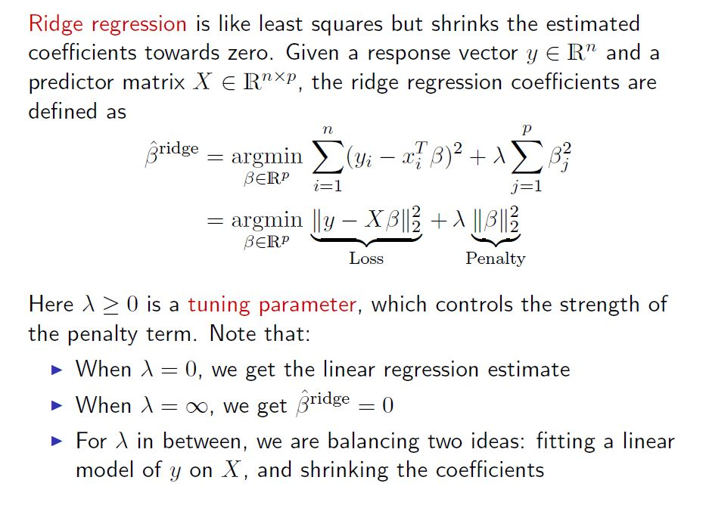

Slide 79
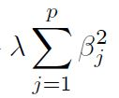
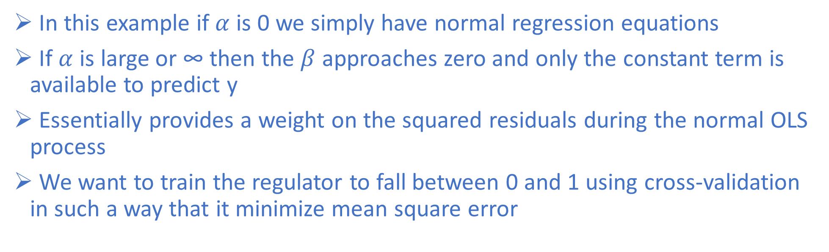
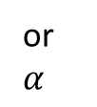
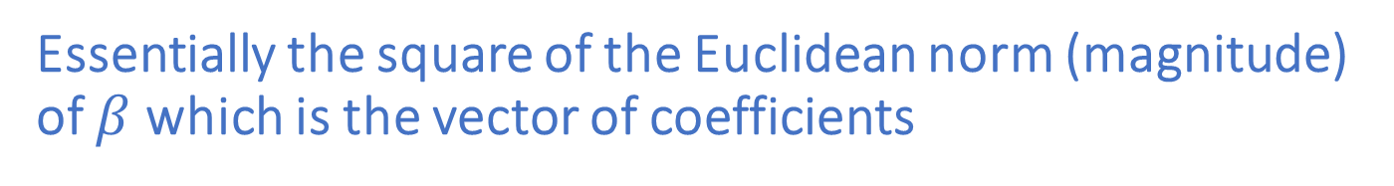
Ridge Penalty
Essentially the square of the Euclidean norm (magnitude) of $β$which is the vector of coefficients
or
$$α$$
In this example if $α$ is 0 we simply have normal regression equations
If $α$ is large or ∞ then the $β$ approaches zero and only the constant term is available to predict y
Essentially provides a weight on the squared residuals during the normal OLS process
We want to train the regulator to fall between 0 and 1 using cross-validation in such a way that it minimize mean square error

Slide 80
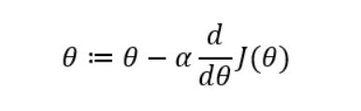
Gradient Decent
Penalized regression methods use a very common algorithm called gradient decent
It is essentially a step function that works to minimize some cost function through a iterative process
Notes:
:= replacement symbol
Theta – starts with random thetas and use these parameters to calculate the output
a: is the learning rate that we establish, larger bigger steps
Next is the derivative of the cost function
Gradually updates the theta values.

Slide 81
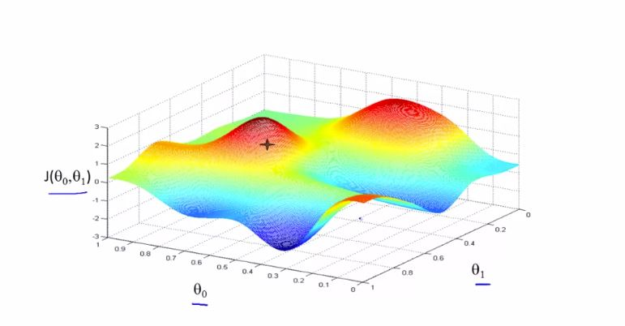
Gradient Decent
Notes:
:= replacement symbol
Theta – starts with random thetas and use these parameters to calculate the output
a: is the learning rate that we establish, larger bigger steps
Next is the derivative of the cost function
Gradually updates the theta values.

Slide 83
L2 Norm or Euclidean Norm or Euclidean Length
In words, the L2 norm is defined as, 1) square all the elements in the vector together; 2) sum these squared values; and, 3) take the square root of this sum.
Square of all the elements in matrix
Sum the values together
Take the square root
Ridge also squares the final result of this, so we are taking the square of the Euclidean norm and multiply this number by the penalty to weight the coefficients

Slide 84
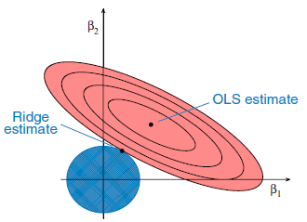
Ridge Visualization
Notes:
Talk about level curves, where z=f(x,y) z is a function of x,y in that it’s essentially the vertical axis of the function, curves represent a region where the values are the same – switch to R

Slide 85

Measuring the Magnitude of Vectors, L2 and L1
$β= \left[\begin{aligned}β0 \\ β1\end{aligned}\right]$
L2 – Norm : II$β$II₂ = $\sqrt{β0}$² + $β1$² : What we used for ridge, essentially calculates the magnitude of the coefficient vector of the regression equation, gives us a bias minimum
L1
Notes:
Draw a vector arrow out from the origin of 2 or 3 and construct the circle, works to control highly correlated variables by control the size growth of the beta coeficients

Slide 86

Measuring the Magnitude of Vectors, L2 and L1
$β= \left[\begin{aligned}β0 \\ β1\end{aligned}\right]$
L1 – Norm : II$β$II₁ = I$β0$I + I$β1$I : What we used for ridge, essentially calculates the magnitude of the coefficient vector of the regression equation, gives us a bias minimum. Cartesian Distance or Euclidean Distance of our vector
Notes:
So if we want the L1 norm to equal 2 for example what would that look like on the plain, draw it graphically
Contours of the residual-sum-of-squares function
B0 = c and B1 = 0 at the corners

Slide 87
Measuring the Magnitude of Vectors, L2 and L1
Notes:
Minimize the sum of square residuals, cap the variance which is common in OLS

Slide 88
Lasso Equation

